Slide 1
Gesture Recognition for Enabling Control of Electrical Devices
David T. Tung
12/07/2024

Slide 2
Advisor Feedback Status
Advisor Feedback Status
· Your data consists of images and metadata about the images. The metadata includes markers, camera information, and the location of the person’s joints. · The markers and camera information serve as ground truth for location data. · There are 2.4 million images showing the person in various positions. · You have completed steps 1 and 2 in the graphical model of your research. You are skipping steps 3 and 4 for now and are currently working on steps 5 and 6. · You are currently working with one tech writer which has reviewed your chapter 2. Next time, we need to review Chapter 2. · The following is the schedule for the remaining chapters of the praxis: o Chapter 3 – Methodology: End of December o Chapter 4 – Results: End of February o Chapter 5 – Discussions & Conclusions: End of March

Slide 3
Glossary of Terms
Term | Definition
Assistive technology | Mobility devices such as walkers and wheelchairs, as well as hardware, software, and peripherals that assist people with disabilities in accessing computers or other information technologies
DeepPoint | This model provides visual recognition and direction estimation of pointing. Also, there is an associated DP dataset consisting of 2.8 M frames.
Zero-shot learning (ZSL) | A machine learning scenario in which an AI model is trained to recognize and categorize objects or concepts without having seen any examples of those categories or concepts beforehand

Slide 4
Acronyms
Acronym | Definition
CNN | Convolutional Neural Network
ML | Machine Learning
YOLO | You only look once (YOLO) is a state-of-the-art, real-time object detection system.
Fast R-CNN | Faster R-CNN is a single-stage model that is trained end-to-end. It uses a novel region proposal network (RPN) for generating region proposals, which save time compared to traditional algorithms.
CVPR | Computer Vision and Pattern recognition Conference
ICCV | International Conference on Computer Vision
ADA | Americans with Disabilities Act
AHS | American Housing Survey
DP | Deep Learning
DLT | Direct Linear Transformation
CF | Confusion Matrix

Slide 5
Problem Statement
(A) Deliverable | (B) Format | (C) WC
Issue | Individuals using wheelchairs often face challenges accessing electrical devices. | 8
Reference | U.S. Department of Housing and Urban Development. (n.d.). Accessibility of America’s Housing Stock: Analysis of the 2011 American Housing Survey (AHS). HUD USER. https://www.huduser.gov/portal/sites/default/files/pdf/accessibility-america-housingStock.pdf | NA
”so what” | Approximately 35% of U.S. housing units may need to be modified to meet the accessibility requirements of the devices. | 12
Reference | U.S. Department of Housing and Urban Development. (n.d.). Accessibility of America’s Housing Stock: Analysis of the 2011 American Housing Survey (AHS). HUD USER. https://www.huduser.gov/portal/sites/default/files/pdf/accessibility-america-housingStock.pdf | NA
Problem Statement | Individuals using wheelchairs often face challenges accessing electrical devices, so approximately 35% of U.S. housing units may need to be modified to meet the accessibility requirements of the devices. | 31
Industry | Assistive technology | NA
PS Elaboration 1 | Even the places that comply with the Americans with Disabilities Act (ADA), individuals using wheelchairs are often required to stretch to reach to electrical switches. | 26
PS Elaboration 2 | Assistive devices, such as canes, robotic arms, intelligent eyewear, mobile phones, or AI-enabled wearables, come with a high cost. | 19

Slide 6
Thesis Statement
(A) Deliverable | (B) Format | C) WC
Thesis Statement | A two-stage classification system is needed to identify the electrical devices pointed at by a wheelchair user, enabling touchless device control and improving accessibility. | 23
Research Product | A two-stage classification system
Format | Python
Deliverable Usage | This technology enables integrators or developers to improve device accessibility, benefiting wheelchair users. | 19
PS Tie Back | Wheelchair users facing challenges accessing electrical devices can leverage gesture-based machine learning technology to improve device accessibility. | 23
New contributions | We present a device classification system to identify the electrical devices a wheelchair user points at. This system leverages pointing direction prediction (based on DeePoint) and object detection as the core ML technology, which can enable touchless device control and improve device accessibility for wheelchair users. | 22
Scope | To evaluate the feasibility of developing a device classification system capable of interpreting gesture-based interactions to improve device accessibility for wheelchair users. The actual electrical device control is excluded. | 17
Methodology | Machine learning, transformer, deep learning, computer vision, object detection
Inputs | Videos featuring a seated individual pointing to electrical devices | NA
Outputs | Device classes ( TV, lamp, floor fan, ceiling fan, AC) and probability of device classification accuracy | NA

Slide 7
Research Question Instructions
(A) Deliverable | (B) Format | C) WC
Research Question 1 | Does tracking gaze direction enhance the accuracy of pointing direction prediction in the first stage of the two-stage classification system? | 21
Research Question 2 | Can a two-stage classification system be developed to identify the electrical devices a wheelchair user points at, enabling touchless device control and improving accessibility? | 24
Research Question 3 | Which ML model works best for the second stage of the two-stage classification system for identification of electrical devices as pointed by wheelchair user? | 23

Slide 8
Research Question Instructions
(A) Deliverable | (B) Format | C) WC
Hypothesis 1 | Tracking gaze direction can improve the accuracy of finger pointing direction prediction by approximately 5% in the first stages of a two-stage classification system. | 24
Independent Vars | Videos featuring a seated individual pointing to various direction | NA
Dependent Var | 3D pointing direction estimation and probability of pointing | NA
Testable | The DeePoint dataset will be divided into 70% for training, 15% for validation, and 15% for testing. The DeePoint model will be fine-tuned by incorporating gaze direction as an additional feature. Experiments will be conducted on a dataset of seated users, with classification results compared to those produced by the original system to assess performance improvements. | 34
Hypothesis 2 | The proposed two-stage classification system can reach 70% accuracy in identifying the electrical devices a wheelchair user points at. | 17
Independent Vars | Videos featuring a seated individual pointing to electrical devices | NA
Dependent Var | Device classes and probability of device classification accuracy | NA
Testable | DeePoint dataset will be split into 70%, 15%, and 15% and used in the training, validation, and test sets to train the custom classification model. Experiments will be conducted on a dataset of seated users to collect the classification results and compare them to the hypothesized 70% accuracy threshold. | 32
Hypothesis 3 | In the second stage, the proposed device classification system incorporating the YOLO model is expected to outperform the model using the Fast R-CNN as an object detection component. | 28
Independent Vars | Videos featuring a seated individual pointing to electrical devices | NA
Dependent Var | Device classes and probability of device classification accuracy | NA
Testable | DeePoint dataset will be split into 70%, 15%, and 15% for the training, validation, and test sets to train two classification systems: one using YOLO and the other using Fast R-CNN for the object detection component. Experiments will be conducted on a dataset of seated users to compare the results between these two models. | 33

Slide 9
Annotated Bibliography
(A) Deliverable | (B) Format | (C) WC
Reference | Nakamura, S., Kawanishi, Y., Nobuhara, S., & Nishino, K. (2023). DeePoint: Visual Pointing Recognition and Direction Estimation. In Proceedings of the IEEE/CVF International Conference on Computer Vision (pp. 20577-20587). | NA
Summary | First-of-its-kind large-scale dataset for pointing recognition and direction estimation consists of 2M frames, 33 people pointing in various styles annotated for each frame with pointing timings and 3D directions. DeePoint is a Transformer-based model that utilizes the spatial and temporal alignment of body parts, beyond just the hands, for combined recognition and 3D directional estimation of pointing gestures. | 58
Methodology | Machine Learning, Transformer, Deep Learning | NA
Evaluation | Paper accepted by the 2023 ICCV conference Git: https://github.com/kyotovision-public/deepoint Data: https://drive.google.com/drive/folders/1W_49HId_2FLFH0X9Ry8QiTTyaVt2Y0ks Limitation: There are not selected objects predicted (their to-do list) | 16
Relevance | Highly matches my goal to provide the prediction of finger-pointing 3D vector This paper provides both a dataset and model for me to start my praxis | 26

Slide 10
Annotated Bibliography
(A) Deliverable | (B) Format | (C) WC
Reference | Cheng, T., Song, L., Ge, Y., Liu, W., Wang, X., & Shan, Y. (2024). Yolo-world: Real-time open-vocabulary object detection. In Proceedings of the IEEE/CVF Conference on Computer Vision and Pattern Recognition (pp. 16901-16911) | NA
Summary | YOLO-World an innovative approach that enhances YOLO with open-vocabulary detection capabilities through vision-language modeling and pre-training on large-scale datasets.
Methodology | Object detection | NA
Evaluation | CVPR 2024 https://github.com/AILab-CVC/YOLO-World | N/A
Relevance | Highly relevant in object detection | 8

Slide 11
Annotated Bibliography
(A) Deliverable | (B) Format | (C) WC
Reference | Girshick, R. (2015). Fast r-cnn. In Proceedings of the IEEE international conference on computer vision (pp. 1440-1448). https://openaccess.thecvf.com/content_iccv_2015/papers/Girshick_Fast_R-CNN_ICCV_2015_paper.pdf | NA
Summary | Fast R-CNN builds on previous work to efficiently classify object proposals using deep convolutional networks. Compared to previous work, Fast R-CNN employs several innovations to improve training and testing speed while also increasing detection accuracy.
Methodology | CNN, Object detection | NA
Evaluation | ICCV 2015 https://github.com/rbgirshick/fast-rcnn | N/A
Relevance | Highly relevant in object detection | 8

Slide 12
Annotated Bibliography
(A) Deliverable | (B) Format | (C) WC
Reference | Constantin, S., Eyiokur, F. I., Yaman, D., Bärmann, L., & Waibel, A. (2022, October). Interactive multimodal robot dialog using pointing gesture recognition. In European conference on computer vision (pp. 640-657). Cham: Springer Nature Switzerland. | NA
Summary | In this work, we tackle this problem and present a system for interactive, multimodal, task-oriented robot dialog using pointing gesture recognition. Specifically, we propose a pipeline constituted of state-of-the-art computer vision components to recognize objects, hands, hand orientation as well as human pose, and combine this information to identify not only pointing gesture presence but also the objects which are pointed at.
Methodology | Machine Learning, CNN, Transformer | NA
Evaluation | ECCV 2022 | N/A
Relevance |  | 8

Slide 13
Annotated Bibliography
(A) Deliverable | (B) Format | (C) WC
Reference | Xie, P., Chen, S., Hu, D., Dai, Y., Yang, K., & Wang, G. (2024). Target-Oriented Object Grasping via Multimodal Human Guidance. arXiv preprint arXiv:2408.11138.
Summary | In this paper, we propose a system designed for target-oriented grasping that responds to humans’ interactive, multimodal guidance instructions
Methodology | Machine Learning, CNN, Transformer
Evaluation | Tsinghua University 2024 | N/A
Relevance | Highly relevant in object detection | 8

Slide 14
Annotated Bibliography
(A) Deliverable | (B) Format | (C) WC
Reference | Zou, C., Wang, B., Hu, Y., Liu, J., Wu, Q., Zhao, Y., ... & Sun, J. (2021). End-to-end human object interaction detection with hoi transformer. In Proceedings of the IEEE/CVF conference on computer vision and pattern recognition (pp. 11825-11834).
Summary | We propose HOI Transformer to tackle human object in- teraction (HOI) detection in an end-to-end manner. Cur- rent approaches either decouple HOI task into separated stages of object detection and interaction classification or introduce surrogate interaction problem. In contrast, our method, named HOI Transformer, streamlines the HOI pipeline by eliminating the need for many hand-designed components.
Methodology | Machine Learning, CNN, Transformer
Evaluation | CVPR 2021 | N/A
Relevance | Highly relevant in object detection | 8

Slide 15
Annotated Bibliography
(A) Deliverable | (B) Format | (C) WC
Reference | Zhu, D., Li, T., Ho, D., Zhou, T., & Meng, M. Q. (2018, October). A novel OCR-RCNN for elevator button recognition. In 2018 IEEE/RSJ International Conference on Intelligent Robots and Systems (IROS) (pp. 3626-3631). IEEE. | NA
Summary | Graft an OCR branch on the Faster RCNN architecture, integrating the detection, localization and labeling task into a single network. Collected a dataset of 2,100 different elevator panels with 21,767 button labels. After 80,000 training steps, the network achieves a detection precision of 94.6% . | 43
Methodology | Machine Learning, RCNN, OCR | NA
Evaluation | Paper accepted by the 2018 IEEE conference (IROS) Git: https://github.com/zhudelong/elevator_button_recognition?tab=readme-ov-file Data: https://mycuhk-my.sharepoint.com/personal/1155067732_link_cuhk_edu_hk/_layouts/15/onedrive.aspx?id=%2Fpersonal%2F1155067732%5Flink%5Fcuhk%5Fedu%5Fhk%2FDocuments%2FElevatorButtonDataset%2Ezip&parent=%2Fpersonal%2F1155067732%5Flink%5Fcuhk%5Fedu%5Fhk%2FDocuments&ga=1 | 16
Relevance | Highly matches my goal to provide the elevator buttons labels and locations This paper provides both a dataset and model for me to start my praxis | 26

Slide 16
Annotated Bibliography
(A) Deliverable | (B) Format | (C) WC
Reference | Liu, J., Fang, Y., Zhu, D., Ma, N., Pan, J., & Meng, M. Q. H. (2021, May). A large-scale dataset for benchmarking elevator button segmentation and character recognition. In 2021 IEEE International Conference on Robotics and Automation (ICRA) (pp. 14018-14024). IEEE. | NA
Summary | The first large-scale publicly available elevator panel dataset is released in this work, containing high-quality 3,718 panel images with 35,100 button labels. The baseline implementations on button segmentation and recognition, as well as evaluation metrics, are also released, for benchmarking future methods and facili- tating related studies on autonomous elevator operation. | 43
Methodology | Machine Learning, RCNN, OCR | NA
Evaluation | Paper accepted by the 2021 IEEE conference (ICRA) Git: https://github.com/zhudelong/elevator_button_recognition https://github.com/zhudelong/elevator_button_recognition | 16
Relevance | Highly matches my goal to provide the elevator buttons labels and locations This paper provides both a dataset and model for me to start my praxis | 26

Slide 17
Annotated Bibliography
(A) Deliverable | (B) Format | (C) WC
Reference | Kim, D., Mollyn, V., & Harrison, C. (2023). WorldPoint: Finger Pointing as a Rapid and Natural Trigger for In-the-Wild Mobile Interactions. Proceedings of the ACM on Human-Computer Interaction, 7(ISS), 357-375. | NA
Summary | Use the recent inclusion of wide-angle, rear-facing smartphone cameras, along with hardware-accelerated machine learning, to enable real-time, infrastructure free, finger-pointing interactions on today’s mobile phones. | 25
Methodology | Machine Learning, Deep Learning, CNN, point cloud | NA
Evaluation | Paper from CMU researchers in 2023 Limitation: require mobile phone | 10
Relevance | Highly relevant in finger-pointed object detection except it is mobile phone-based and there is no device control. | 18

Slide 18
Annotated Bibliography
(A) Deliverable | (B) Format | (C) WC
Reference | Liu, C., Hu, Y., Li, Y., Song, S., & Liu, J. (2017). Pku-mmd: A large scale benchmark for continuous multi-modal human action understanding. arXiv preprint arXiv:1703.07475. | NA
Summary | PKU-MMD is a new large scale benchmark for continuous multi-modality 3D human action understanding and covers a wide range of complex human activities with well annotated information. PKU-MMD contains 2 phases, for action detection tasks with increasing difficulty. Phase 1 is large-margin action detection task. Phase 2 is small-margin action detection task. Our dataset also provides multi-modality data sources, including RGB, depth, Infrared Radiation and Skeleton. We believe this large-scale dataset will benefit future researches on action detection for the community.
Methodology | Machine Learning, Deep Learning, CNN | NA
Evaluation | Paper from PKU researchers in 2017, which is a Large Scale Benchmark for Continuous Multi-Modal Human Action Understanding Limitation: require mobile phone | 19
Relevance | Cross validation | 18

Slide 19
Annotated Bibliography
(A) Deliverable | (B) Format | (C) WC
Reference | Mousavian, A., Anguelov, D., Flynn, J., & Kosecka, J. (2017). 3d bounding box estimation using deep learning and geometry. In Proceedings of the IEEE conference on Computer Vision and Pattern Recognition (pp. 7074-7082). | NA
Summary | Recover the 3D bounding boxes for known object categories from a single view. Using a novel MultiBin loss for orientation prediction and an effective choice of box dimensions as regression parameters. This method estimates stable and accurate posed 3D bounding boxes without additional 3D shape models, or sampling strategies with complex pre-processing pipelines.
Methodology | Machine Learning, Deep Learning | NA
Evaluation | Paper accepted by the 2017 CVPR conference Git: https://github.com/skhadem/3D-BoundingBox Limitation: | 10
Relevance | Highly relevant in object detection and 3D bounding box | 9

Slide 20
Annotated Bibliography
(A) Deliverable | (B) Format | (C) WC
Reference | Yang, L., Kang, B., Huang, Z., Xu, X., Feng, J., & Zhao, H. (2024). Depth anything: Unleashing the power of large-scale unlabeled data. In Proceedings of the IEEE/CVF Conference on Computer Vision and Pattern Recognition (pp. 10371-10381). | NA
Summary | Depth Anything is trained on 1.5M labeled images and 62M+ unlabeled images jointly, providing the most capable Monocular Depth Estimation (MDE) foundation models with the following features: zero-shot relative depth estimation, better than MiDaS v3.1 (BEiT_{L-512}) zero-shot metric depth estimation, better than ZoeDepth optimal in-domain fine-tuning and evaluation on NYUv2 and KITTI
Methodology | Machine Learning, Deep Learning | NA
Evaluation | Paper accepted by the 2024 CVPR conference https://github.com/LiheYoung/Depth-Anything | 10
Relevance | Highly relevant in depth estimation | 5

Slide 21
Annotated Bibliography
(A) Deliverable | (B) Format | (C) WC
Reference | Zhang, C., Ling, Y., Lu, M., Qin, M., & Wang, H. (2024). Category-level Object Detection, Pose Estimation and Reconstruction from Stereo Images. arXiv preprint arXiv:2407.06984. | NA
Summary | This paper presents CODERS, a one-stage approach for Category-level Object Detection, pose Estimation, and Reconstruction from Stereo images. The base of our pipeline is an Implicit Stereo Matching module that combines stereo image features with 3D position information.
Methodology | Machine Learning, Deep Learning | NA
Evaluation | Paper accepted by the 2024 ECCV conference https://xingyoujun.github.io/coders/?fbclid=IwZXh0bgNhZW0CMTAAAR0IGuyn2xHbrdY8_1iNNBVrR8IMKn_H4LafpzmT2gGTYp5Lps7dW2Al0aQ_aem_-NUraQYijssC2jZ3SSFvBQ#todo | 10
Relevance | Highly relevant in 3D object bounding box estimation | 8

Slide 22
Annotated Bibliography
(A) Deliverable | (B) Format | (C) WC
Reference | Jirak, D., Biertimpel, D., Kerzel, M., & Wermter, S. (2021). Solving visual object ambiguities when pointing: an unsupervised learning approach. Neural Computing and Applications, 33, 2297-2319. | NA
Summary | In this paper, we propose an unsupervised learning approach to model the distribution of pointing gestures using a growing-when-required (GWR) network. We introduce an interaction scenario with a humanoid robot and define the so-called ambiguity classes.
Methodology | Unsupervised learning | NA
Evaluation | Paper published in 2021 https://link.springer.com/article/10.1007/s00521-020-05109-w | 10
Relevance | Highly relevant in gesture object detection processing | 8

Slide 23
Annotated Bibliography
(A) Deliverable | (B) Format | (C) WC
Reference | Jirak, D., Biertimpel, D., Kerzel, M., & Wermter, S. (2021). Solving visual object ambiguities when pointing: an unsupervised learning approach. Neural Computing and Applications, 33, 2297-2319. | NA
Summary | In this paper, we propose an unsupervised learning approach to model the distribution of pointing gestures using a growing-when-required (GWR) network. We introduce an interaction scenario with a humanoid robot and define the so-called ambiguity classes.
Methodology | Unsupervised learning | NA
Evaluation | Paper published in 2021 https://link.springer.com/article/10.1007/s00521-020-05109-w | 10
Relevance | Highly relevant in gesture object detection processing | 8

Slide 24
Annotated Bibliography
(A) Deliverable | (B) Format | (C) WC
Reference | Cheng, T., Song, L., Ge, Y., Liu, W., Wang, X., & Shan, Y. (2024). Yolo-world: Real-time open-vocabulary object detection. In Proceedings of the IEEE/CVF Conference on Computer Vision and Pattern Recognition (pp. 16901-16911). | NA
Summary | The You Only Look Once (YOLO) series of detectors have established themselves as efficient and practical tools. However, their reliance on predefined and trained object categories limits their applicability in open scenarios. Addressing this limitation, we introduce YOLO-World, an innovative approach that enhances YOLO with open-vocabulary detection capabilities through vision-language modeling and pre-training on large-scale datasets. Specifically, we propose a new Re-parameterizable Vision-Language Path Aggregation Network (RepVL-PAN) and region-text contrastive loss to facilitate the interaction between visual and linguistic information. Our method excels in detecting a wide range of objects in a zero-shot manner with high efficiency. On the challenging LVIS dataset, YOLO-World achieves 35.4 AP with 52.0 FPS on V100, which outperforms many state-of-the-art methods in terms of both accuracy and speed. Furthermore, the fine-tuned YOLO-World achieves remarkable performance on several downstream tasks, including object detection and open-vocabulary instance segmentation.
Methodology | Deep Learning, object detection | NA
Evaluation | Paper published in 2024 https://github.com/AILab-CVC/YOLO-World | 10
Relevance | Highly relevant in object detection | 8

Slide 25
Data Sources List
ID | Name | Source | Brief Description | Format | Time Span | Num. of records | Access (Y/N)
1 | Deepoint (DP) dataset | https://drive.google.com/drive/folders/1W_49HId_2FLFH0X9Ry8QiTTyaVt2Y0ks | First-of-its-kind largescale dataset for pointing recognition and 3D direction estimation. License: CC BY-NC 4.0 ICCV 2023 | Jpeg, json, yaml | 2023 | 2.8 M frames | Y
2 | PKU-MMD dataset | https://github.com/ECHO960/PKU-MMD | PKU Multi-Modality Dataset) is a large-scale benchmark for continuous multi-modal 3D human action understanding. It covers a wide range of complex human activities with well-annotated information. For cross validation License: Apache 2.0 | Jpeg, png, avi, label | 2017 | 5.4 M frames | Y

Slide 26
Data Source Example
For each of data sources listed in your Data Sources List slide, complete a Data Source Example slide.
ID | Name | Source | Brief Description | Format | Time Span | Num. of records | Access (Y/N)
1 | DP dataset | 2023-01-17-livingroom/take1/00/ | Images for pointing recognition and 3D direction estimation in living room | JPG | 2023 | 100 | Y
Purpose: The image will be utilized for body pose estimation and the pose estimation will be used as input to the encoder for training purposes to predict the pointing direction.
Data treatment: The primary process will involve filtering out non-sitting positions using pose estimation.
Sample data: (next slide)

Slide 27
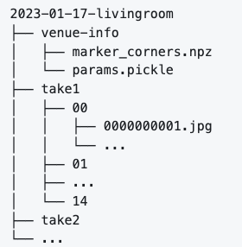
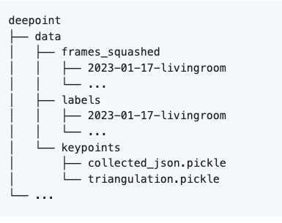
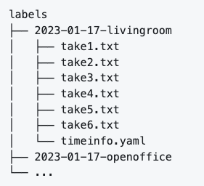

DeePoint sample metadata
Takeaway:
Venue: marker and camera param info
Take#n: images frame ( from video)
Labels: marker and pointing frames relationship ( which frame pointing to which marker)
Keypoints: body pose info

Slide 28
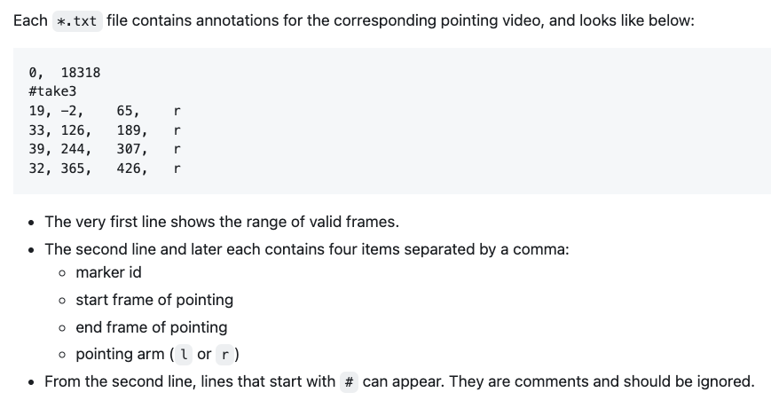
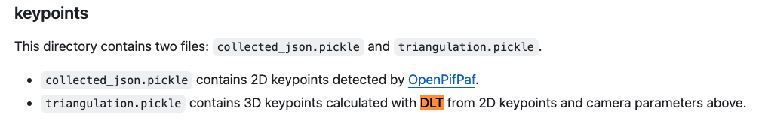
DeePoint sample metadata (cont)

Slide 29
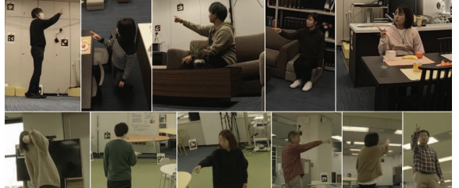
DeePoint Sample data
Takeaway:
Pointing data from DeePoint can be used for the classification transformer training.

Slide 30
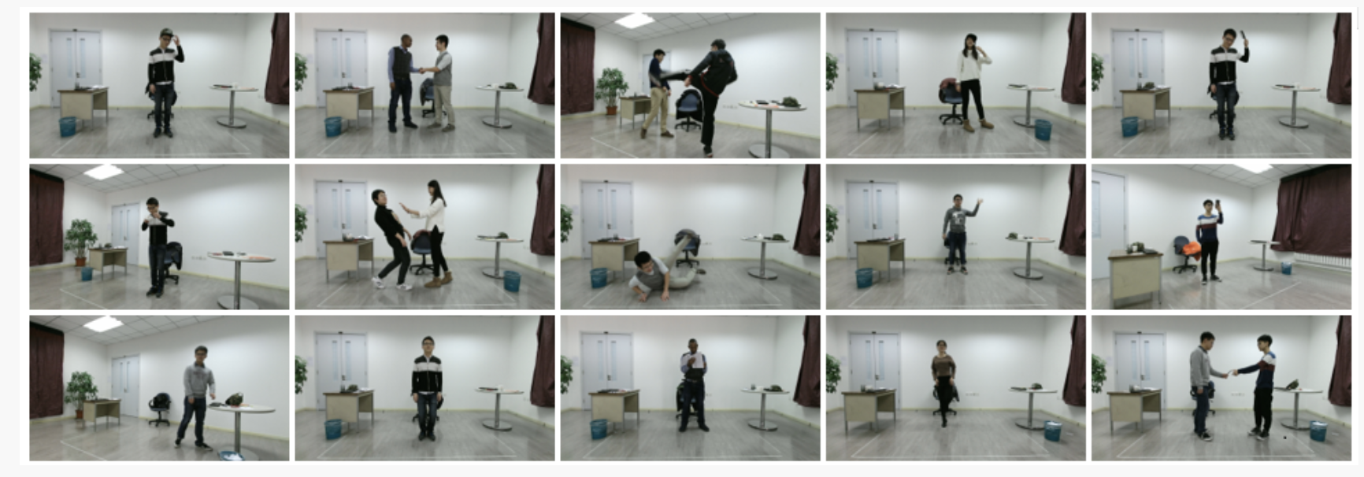
PKU-MMD data sample
Takeaway:
PKU-MMD pointing data can be used for evaluation purposes.

Slide 31
Block Diagram of Pointing Objects Classification – Level 1
1. Data Collection and Infrastructure Setup
Acquire the required video and image datasets to train the model.
Tools Needed: Python, AWS S3, Visual Studio, Git, SageMaker, Amazon Elastic File System (eFS), and EC2.
2. Pre-Process Data
Perform data analysis on the DeePoint dataset
Build dataloader
Split the data into training, test, and validation sets.
Tools: Python, SageMaker, S3, Spark, EC2
3. Enhance the DeePoint model to account for gaze direction in model training
Modify the model training loss function to account for gaze direction and train the model
Tools: Python, SageMaker, PyTorch, EC2
4. Evaluate the accuracy of the fine-tuned DeePoint model to assess its performance and accuracy
Evaluate the system with the prepared dataset
Compare performance number
Tools: Python, PyTorch, EC2,S3
5. Set up the two-stage device classification system
Generate training image data from the DeePoint training videos.
Tools: Python, Pytorch, Sagemaker
6. Build and train the classification transformer (2nd stage) using pre-processed image data
Train transformer with images dataset from step 5
Tools: Python, SageMaker, PyTorch, EC2
7. Evaluate the accuracy of the entire device classification to assess its performance and accuracy.
Run pipeline with the test dataset
Document performance ( precision, recall)
Tools: Python, Pytorch, CF matrix
8. Setup proposed device classification system and integrate it with a Fast R-CNN model
Prepare Fast R-CNN Sagemaker, EC2
Tools: Python.
9. Adapt the computation logic to integrate with Fast R-CNN for object detection and classification tasks.
Similar to step 6 as well as the loss function except it is for Fast R-CNN
Tools: Python.
10. Evaluate the accuracy of the entire device classification to assess its performance and accuracy.
Run pipeline with test the dataset
Document performance ( precision, recall)
Tools: Python, Pytorch, CF matrix

Slide 32

Methodology Steps – Box 1 – Second Level
1.1 Establish cloud infrastructure: Utilize AWS EC2 and S3 for storing training data.
Register for an AWS account.
Launch an EC2 instance and set up S3 storage.
Create a SageMaker domain.
Check if the data requires Parquet format.
Make sure the EC2 instance is reachable remotely via SSH.
1. Data Collection and Infrastructure Setup
Acquire the required video and image datasets to train the model.
Tools Needed: Python, AWS S3, Visual Studio, Git, SageMaker, Amazon Elastic File System (eFS), and EC2.
1.2 Download Data from the cloud
Transfer the Deepoint dataset from Google Drive to AWS S3 storage
Collect the device dataset and copy it to S3
1.3 Mount DeePoint data on EC2
Make data available to EC2 for later use (training & evaluation)
Mount Deepoint data as a squash file system on EC2 instance
1.4 Analyze and verify data
Data analysis using SageMaker notebook and Python
Verify downloaded data (size, checksum…)
Document metrics/statistics (mean, max, min, std…)

Slide 33
Methodology Steps – Box 2 – Second Level
2.1 Prepare cloud environment for data processing
Transfer data from S3 to EC2 drive
Establish a Spark cluster for distributed data processing
Construct dataset and dataloader
Integrate with Weight and Bias to catch training logging
2. Pre-Process Data
Generate training data from the DeePoint training videos.
Split the data into training, test, and validation sets.
Build dataloader
Tools: Python, SageMaker, S3, Spark, EC2
2.2 Filter data to retain valid image frames for training
Develop programming logic to filter images featuring pointing gestures.
Generate training data based on DeePoint’s training dataset.
2.3 Separate data into training, test, and validation sets.
70% training, 20% validation and 10% testing
2.4 Data verification
Verify results to contain valid images for training
Record and save statistics and outcomes.

Slide 34
Methodology Steps – Box 3 – Second Level
3.1 Setup cloud environment for model training
Prepare SageMaker and GPUs
Prepare distributed training if needed
3. Enhance the DeePoint model to account for gaze direction in model training.
Modify the model training loss function to account for gaze direction and train the model
Tools: Python, SageMaker, PyTorch, EC2
3.2 Prepare training pipeline
Define the loss function to account for gaze direction as one of the key factors in the loss computation.
3.3 Train the DeePoint model based on training data from the pre-processing step
Launch training with distributed capability
Monitor and record training loss to complete the training experiments
3.4 Validation
Validate with the validation dataset
Document training stats: CF matrix, loss curve, etc.
Iterate the training process as needed
Pick the best-performed model

Slide 35
Methodology Steps – Box 4 – Second Level
4.1 Setup environment for evaluation
Set up eval pipeline
Setup database for storing results
Prepare test data for evaluation
4. Evaluate the accuracy of the fine-tune DeePoint model to assess its performance and accuracy.
Evaluate the system with the prepared dataset
Compare performance number
Tools: Python, PyTorch, EC2,S3
4.2 Run the model inference with test data
Run pipeline with the model selected in the training step
Collect results and store in a database
Write a program to read results and calculate precision/recall
Compare performance (precision/recall) with DeePoint baseline
4.3 Document and compare results
Document precision/recalls and the comparison with the baseline. (for H1)
Hypothesis

Slide 36
Methodology Steps – Box 5 – Second Level
5.1 System setup
Setup two-stage classification in AWS env
Setup experiment management software in AWS env
5. Set up the two-stage device classification system
Generate training image data from the DeePoint training videos.
Tools: Python, Pytorch, Sagemaker
5.2 Test model
Run evaluation with small set of test dataset
Make sure the end-to-end system works with experiment management

Slide 37
Methodology Steps – Box 6 – Second Level
6.1 Design and implement the device classification transformer
Implement the logic using predicted pointing vector
Implement the logic to convert 2D data to 3D
6. Build and train the classification transformer (2nd stage) using pre-processed image data
Train transformer with images dataset from step 5
Tools: Python, SageMaker, PyTorch, EC2
6.2 Test and debug algorithm with sample data, compare the results with DeePoint approach
6.3 Integrate the pointing direction algorithm and make it available to the pipeline

Slide 38
Methodology Steps – Box 7 – Second Level
7.1 Setup AWS environment for system evaluation
7. Evaluate the accuracy of the entire device classification to assess its performance and accuracy.
Run pipeline with the test dataset
Document performance (-precision, recall)
Tools: Python, Pytorch, CF matrix
7.2 Run end-to-end pipeline
Run the pipeline with custom dataset and images
7.3 Document and collect results (-precision/recall/F1)
Results for H2
Hypothesis

Slide 39
Methodology Steps – Box 8 – Second Level
8.1 Model setup
Setup Fast R-CNN model for object detection component in AWS env
8. . Setup proposed device classification system and integrate it with a Fast R-CNN model
Prepare Fast R-CNN model in AWS env
Sagemaker, EC2
8.2 Test model
Run selected Fast RCNN model with test dataset
Make sure that bounding box coordinates and classification available as outputs
Compare results with YOLO

Slide 40
Methodology Steps – Box 9 – Second Level
9.1 Review and update all the computation logic in the loss function and integrate with Fast R-CNN model
9. Adapt the computation logic in loss function to integrate with Fast R-CNN for object detection and classification tasks.
Update the loss function except it is for Fast R-CNN
Tools: Python.
9.2 Test and debug algorithm with sample data
9.3 Integrate the computation logic/algorithm and make it available to the pipeline

Slide 41
Methodology Steps – Box 10 – Second Level
10.1 Setup environment for evaluation
10. Evaluate the accuracy of the entire device classification to assess its performance and accuracy
Test pipeline with preprocessing dataset
Document performance ( precision, recall)
Tools: Python, Pytorch, CF matrix
10.2 Run end-to-end pipeline
Run the pipeline with pre-processing dataset and images
10.3 Document and collect results ( precision/recall/F1)
Compare with YOLO approach
Results for H3
Hypothesis 3

Slide 42
Does tracking gaze direction enhance the accuracy of pointing direction predictions in the first stage of the two-stage classification system?
Methodology Steps – Box 11 – Second Level
11.1 Final document results for RQ1
RQ1: Is the proposed classification system capable of accurately classifying the device a wheelchair user points at?
11. Final conclusion
Discuss results of experimentation
Discuss models and code structure
Discuss tools used or explored
11.2 Final document results for RQ2
RQ2: Can a two-stage classification system be developed to identify the electrical devices a wheelchair user points at, enabling touchless device control and improving accessibility?
11.3 Final document results for RQ3
Which ML model works best for the second stage of the two-stage classification system for identification of electrical devices, as pointed by wheelchair user?

Slide 43
Appendix

Slide 44
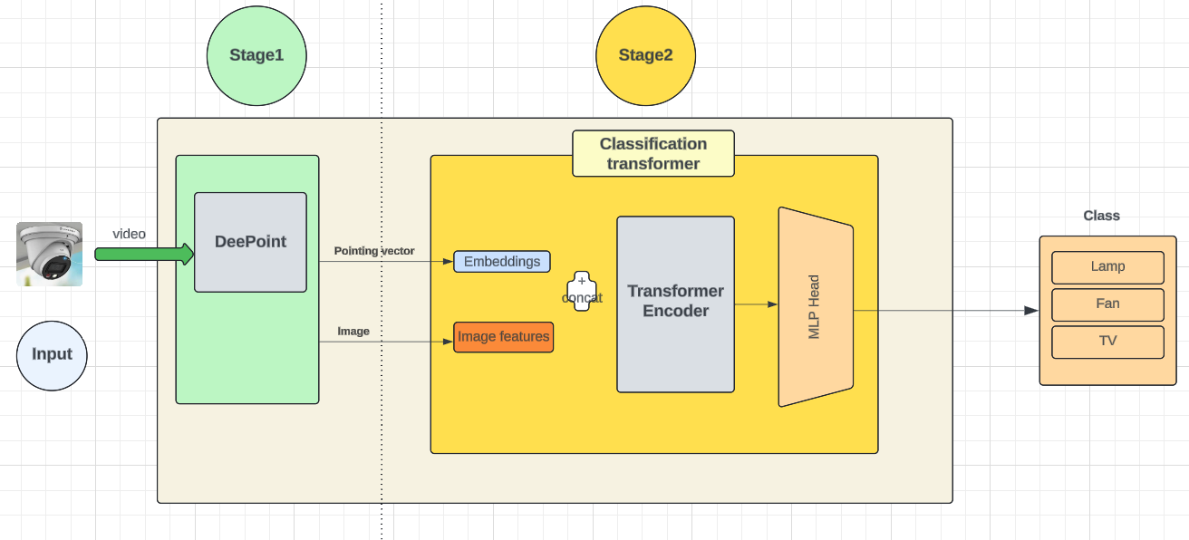
Architecture for Device Classification System
Key takeaways:
This design is two-stage classification system using transformer technology
In 2nd stage, Yolo extracts image features and combines them with pointing vector embedding

Slide 45
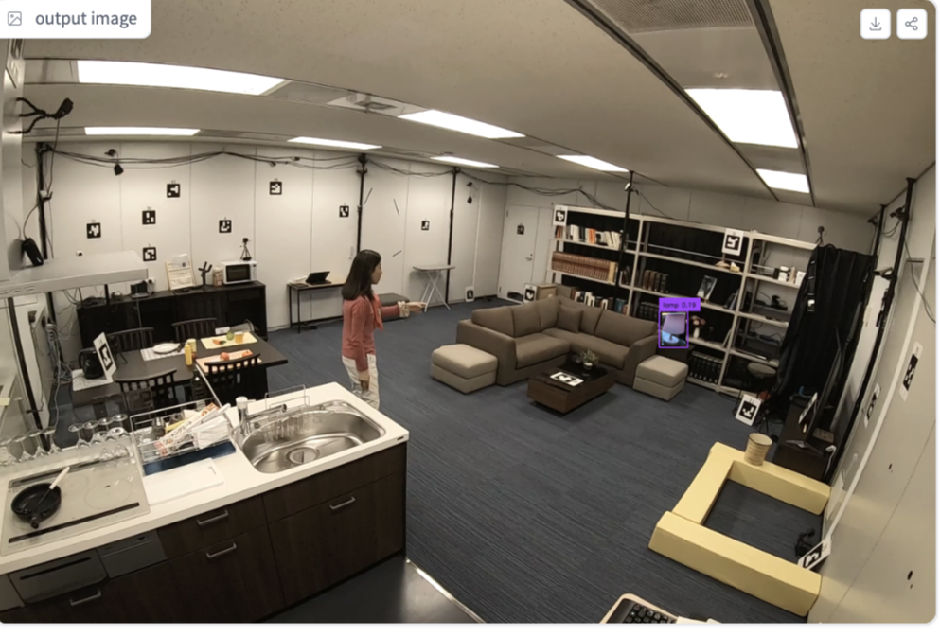
DeePoint experiment example
Takeaways:
Multiple scenes
Markers for pointing direction
Regular camera
Long distance pointing

Slide 46
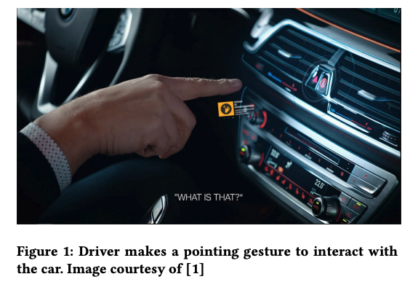
Similar paper – 2020 ICMI (U. of Saarland, BMW, DFKI) Title: You Have a Point There: Object Selection Inside an Automobile Using Gaze, Head Pose and Finger Pointing
Key takeaways:
Very similar paper (concept, goals…)
Differences ( vs my praxis):
Applied to cars
Use pointing, gaze (eyes), head pose as inputs
More hardware solutions (expensive)
Adopt CNN model
The gesture camera system detects a finger-pointing gesture and calculates the vector from the tip of the finger to the base of the finger.

Slide 47
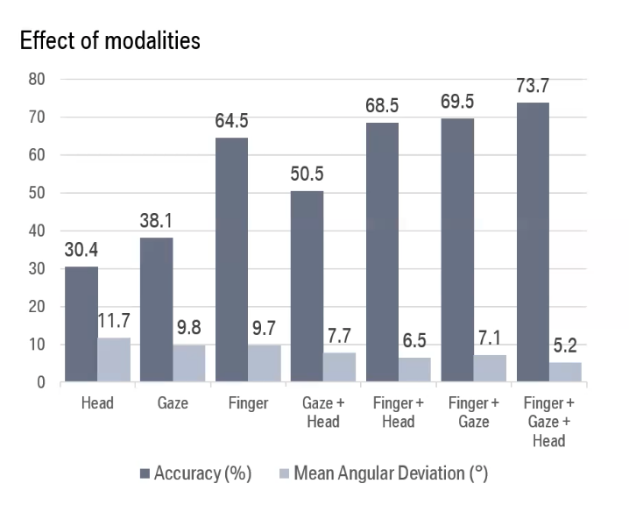
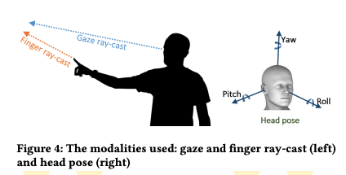
Similar paper – 2020 ICMI (U. of Saarland, BMW, DFKI) Title: You Have a Point There: Object Selection Inside an Automobile Using Gaze, Head Pose and Finger Pointing (Cont.)
Key takeaways:
~5% improvement when adding gaze direction.

Slide 48

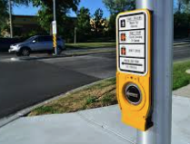
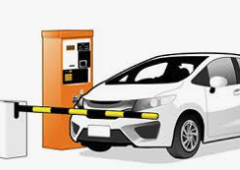
Future Applications using pointing gesture
Takeaways: Pointing technology can be applied
to many different applications as shown above.

Slide 49
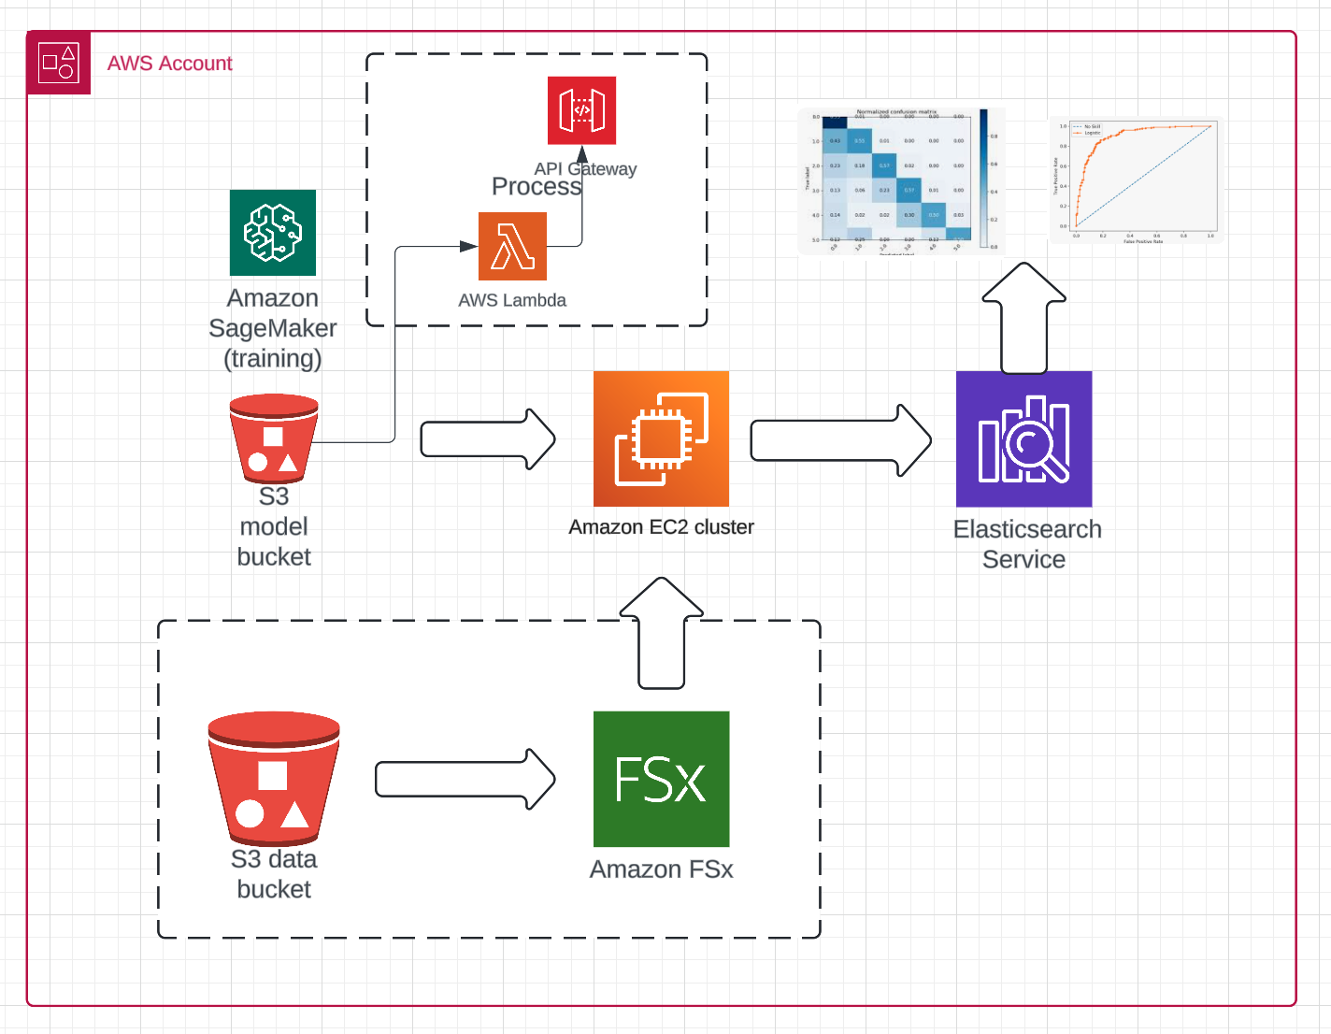
AWS Infrastructure
Takeaways: Set up AWS cloud env for auto MLOps

Slide 50
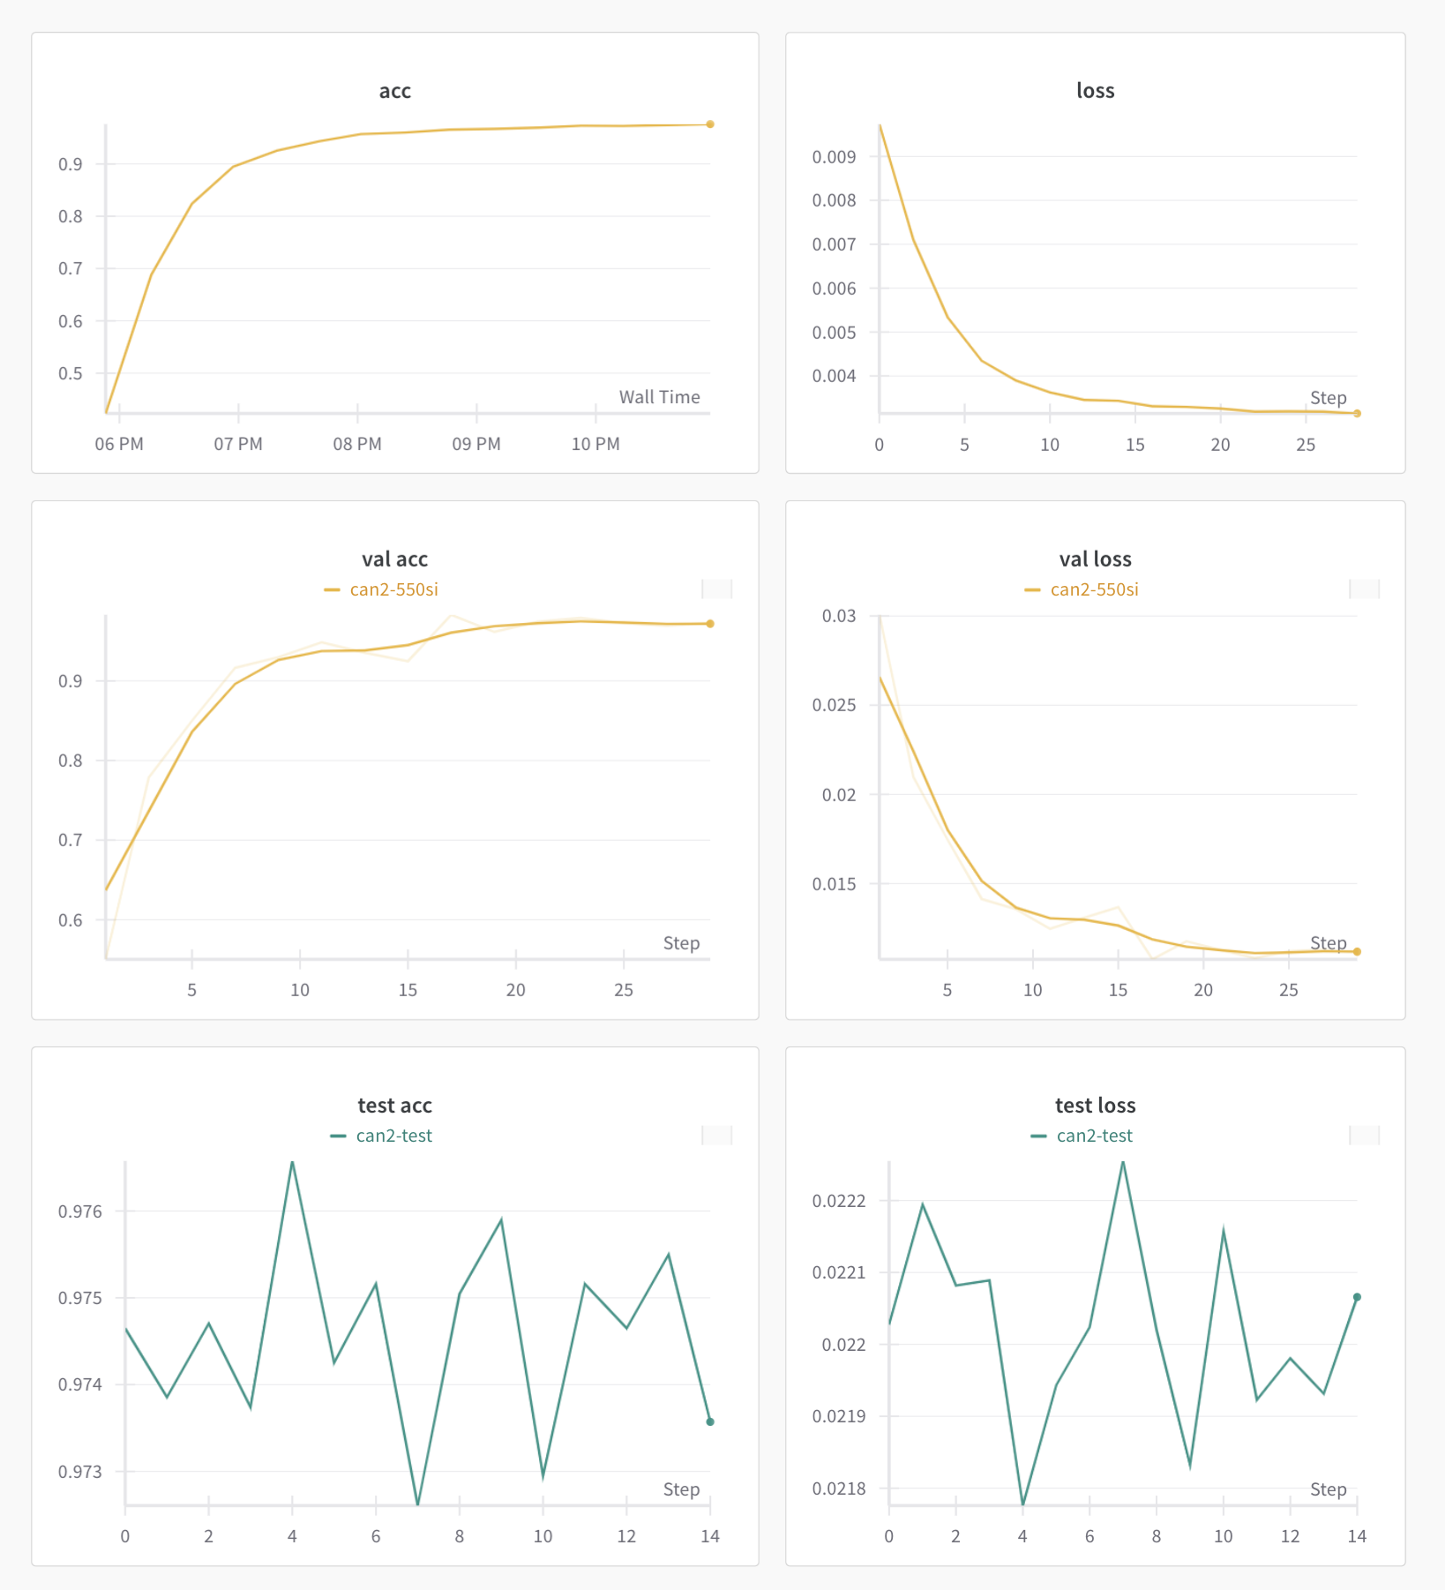
Training results
Takeaways: Preliminary training/val results from W&B dashboard shows very promising

